Slide 1

Vector Integral Calculus
Lecture 4
Green’s theorem in the plane
Surfaces S in $R^{3}$

Slide 2
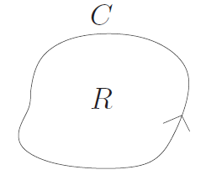
Green’s theorem in the plane
Green’s theorem in the plane:
gives the relationship between a line integral around a simple closed curve C and a double integral over the plane region R bounded by C .
We assume that the plane region R consists of all points inside C as well as all points on C
is useful because it allows us to translate difficult line integrals into more simple double integrals, or difficult double integrals into more simple line integrals
J. Schmiegel: Lecture notes

Slide 3
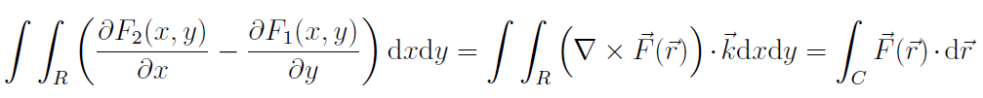
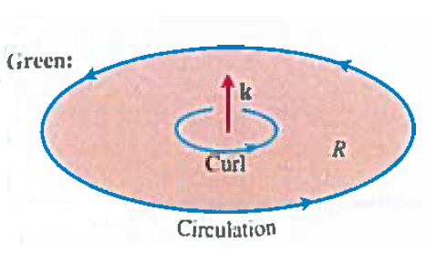
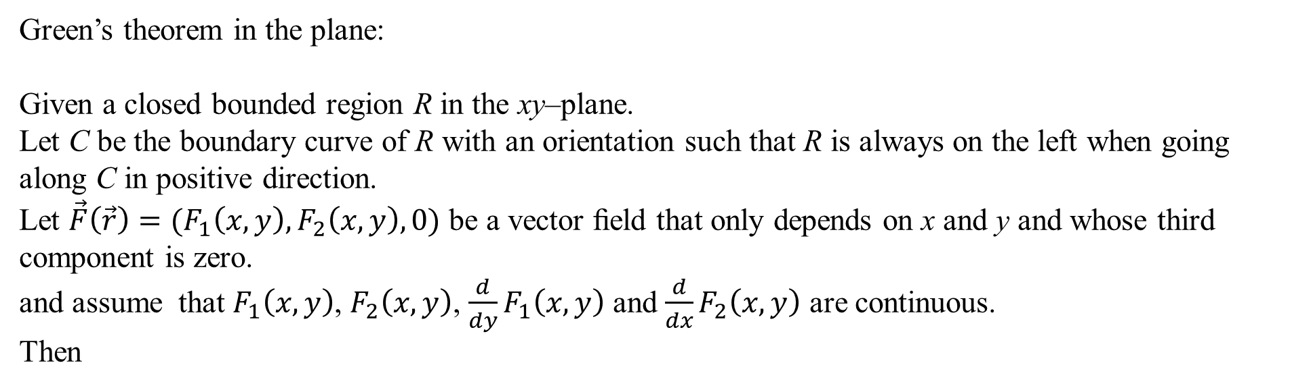
Green’s theorem in the plane
Green’s theorem in the plane:
Given a closed bounded region R in the xy–plane.
Let C be the boundary curve of R with an orientation such that R is always on the left when going along C in positive direction.
Let $\vec{F}\left(\vec{r}\right)=(F_{1}\left(x,y\right),F_{2}\left(x,y\right),0)$ be a vector ﬁeld that only depends on x and y and whose third component is zero.
and assume that $F_{1}\left(x,y\right)$, $F_{2}\left(x,y\right)$, $\frac{d}{dy}F_{1}\left(x,y\right)$ and $\frac{d}{dx}F_{2}\left(x,y\right)$ are continuous.
Then
J. Hass, D. Weir, G. Thomas:
University Calculus: Early Transcendentals

Slide 4
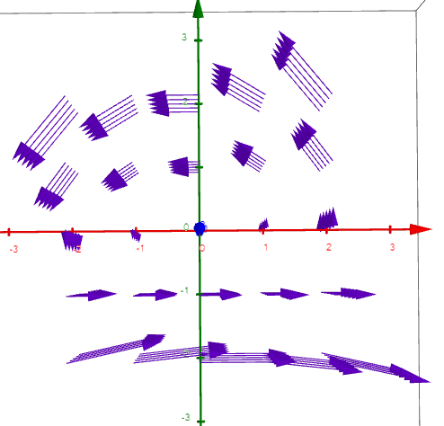
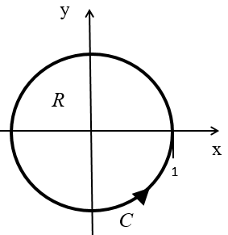




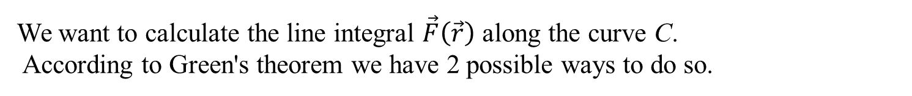

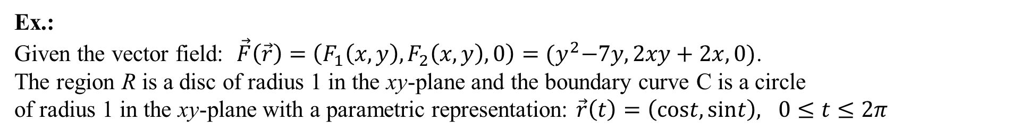
Green’s theorem in the plane
Ex.:
Given the vector field: $\vec{F}\left(\vec{r}\right)=\left(F_{1}\left(x,y\right),F_{2}\left(x,y\right),0\right)={(y}^{2}−7y,2xy+2x,0)$.
The region R is a disc of radius 1 in the xy-plane and the boundary curve C is a circle
of radius 1 in the xy-plane with a parametric representation: $\vec{r}\left(t\right)=\left(cost,sint\right), 0≤t≤2π$
We want to calculate the line integral $\vec{F}\left(\vec{r}\right)$ along the curve C.
According to Green's theorem we have 2 possible ways to do so.
Possibility 1: LS
Possibility 2: RS
$$=9π$$

Slide 5

Application: Area of a closed bounded region
Given a closed bounded region R in the xy–plane with boundary curve C given by $\vec{r}\left(t\right)=\left(x\left(t\right),y\left(t\right),0\right).$
Let $\vec{F}\left(\vec{r}\right)$ be a vector ﬁeld that only depends on x and y and whose third component is zero.
Choosing $F_{1}\left(x,y\right)=0$ and $F_{2}\left(x,y\right)=x$ and using Green’s theorem we get:
Choosing $F_{1}\left(x,y\right)=−y$ and $F_{2}\left(x,y\right)=0$ and using Green’s theorem we get:
I.e. the area of a region R in terms of a line integral along its boundary curve C is
J. Schmiegel: Lecture notes

Slide 6
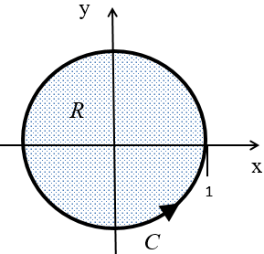
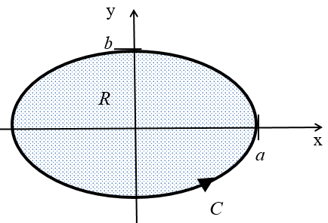
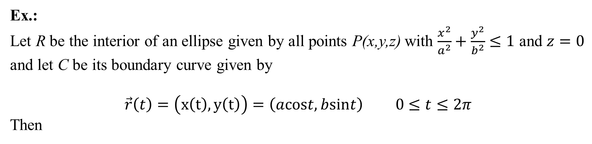
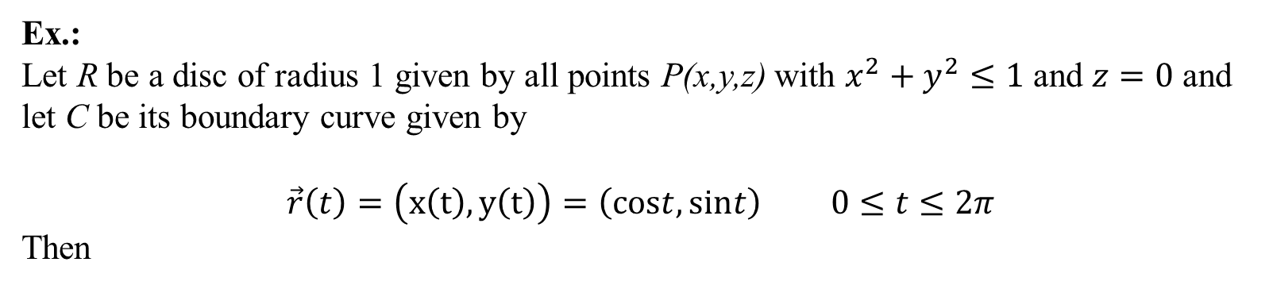
Area of a closed bounded region
Ex.:
Let R be a disc of radius 1 given by all points P(x,y,z) with $x^{2}+y^{2}≤1$ and $z=0$ and
let C be its boundary curve given by
$$\vec{r}\left(t\right)=\left(x\left(t\right),y\left(t\right)\right)=\left(cost,sint\right) 0≤t≤2π$$
Then
Ex.:
Let R be the interior of an ellipse given by all points P(x,y,z) with $\frac{x^{2}}{a^{2}}+\frac{y^{2}}{b^{2}}≤1$ and $z=0$ and let C be its boundary curve given by
$$\vec{r}\left(t\right)=\left(x\left(t\right),y\left(t\right)\right)=\left(acost,bsint\right) 0≤t≤2π$$
Then

Slide 8
Surfaces
Now we are going to:
mathematically describe surfaces
do calculations with surfaces
Potential applications:
calculation of the area of a surface
the calculation of the ﬂux of a ﬂuid through a surface (next time)

Slide 9
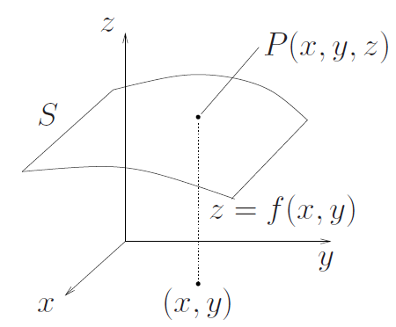
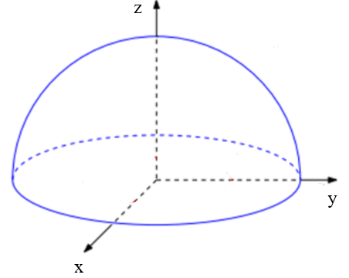
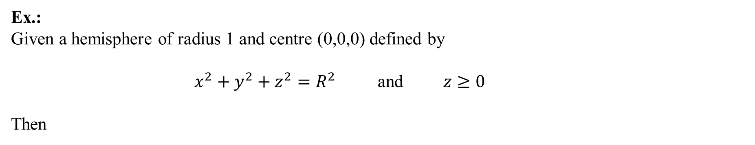
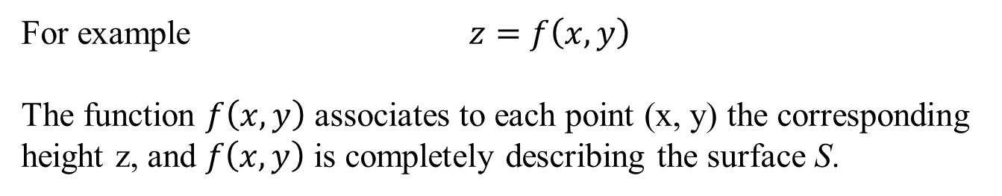
Surfaces S in $R^{3}$
A surface S in $R^{3}$ consisting of the points P(x,y,z) can be described by an equation relating the three coordinates x, y and z.
For example $z=f\left(x,y\right)$
The function $f\left(x,y\right)$ associates to each point (x, y) the corresponding height z, and $f\left(x,y\right)$ is completely describing the surface S.
J. Schmiegel: Lecture notes
Ex.:
Given a hemisphere of radius 1 and centre (0,0,0) defined by
$x^{2}+y^{2}+z^{2}=R^{2}$ and $z≥0$
Then

Slide 10

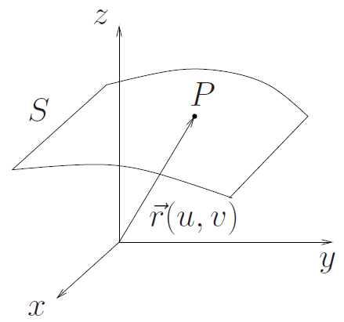
Parametric representation of a surface S
A parametric representation of a surface S is described by the position vectors of the points on S
where u and v are suitable variables within a certain range.
J. Schmiegel: Lecture notes

Slide 11
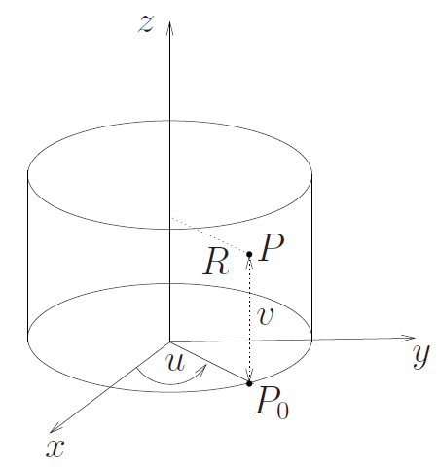
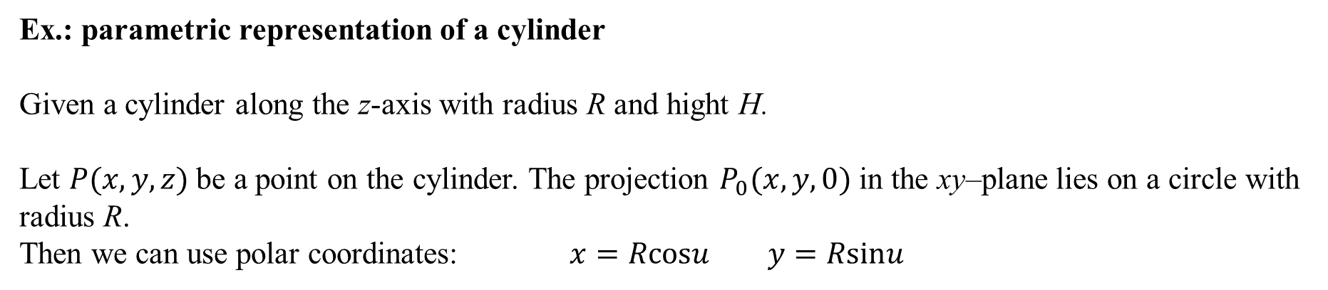
Parametric representation of a surface S
Ex.: parametric representation of a cylinder
Given a cylinder along the z-axis with radius R and hight H.
Let $P(x,y,z)$ be a point on the cylinder. The projection $P_{0}(x,y,0)$ in the xy–plane lies on a circle with radius R.
Then we can use polar coordinates: $x=Rcosu$ $y=Rsinu$
where u is the angle between the x–axis and the position vector ${\vec{r}}_{0}=(x,y,0)$ of $P_{0}$.
The z–coordinate of $P(x,y,z)$ is: $z=v$
J. Schmiegel: Lecture notes
Then we have the parametric representation
$\vec{r}\left(u,v\right)=\left(Rcosu,Rsinu,v\right) 0≤u≤2π 0≤v≤H$

Slide 12
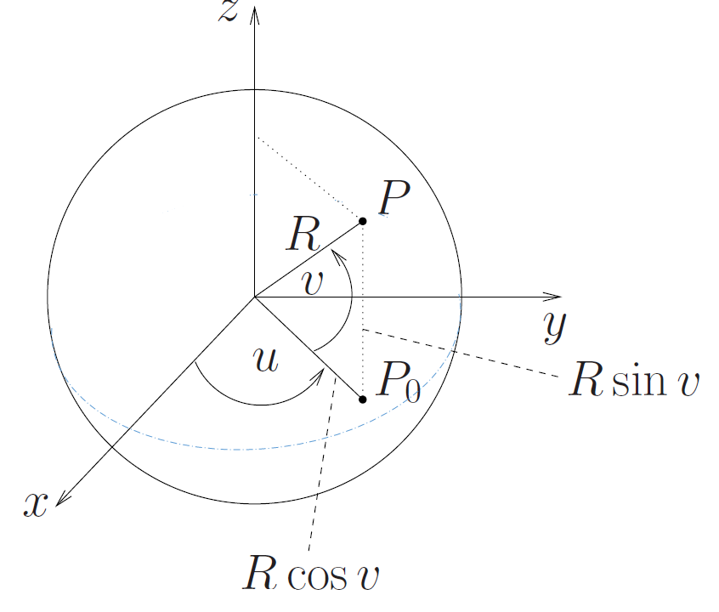
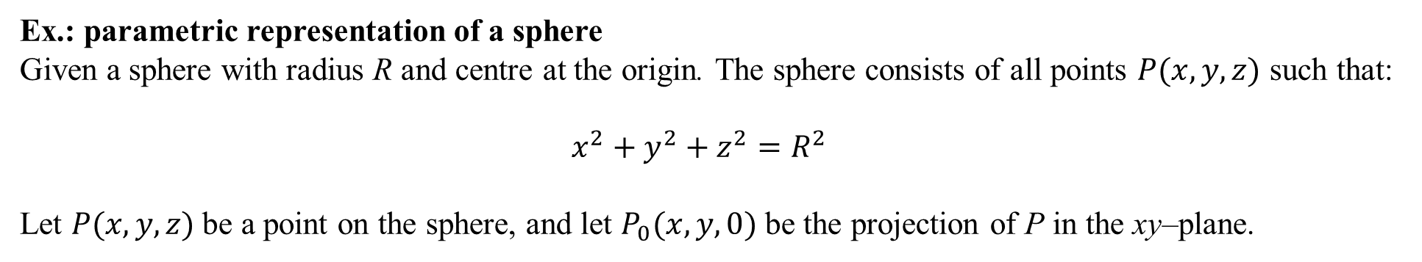
Parametric representation of a surface S
Ex.: parametric representation of a sphere
Given a sphere with radius R and centre at the origin. The sphere consists of all points $P(x,y,z)$ such that:
$x^{2}+y^{2}+z^{2}=R^{2}$
Let $P(x,y,z)$ be a point on the sphere, and let $P_{0}(x,y,0)$ be the projection of P in the xy–plane.
The variable u is the angle between the x–axis and the position vector ${\vec{r}}_{0}=(x,y,0)$ of $P_{0}$.
The variable v is the angle between ${\vec{r}}_{0}$ and the position vector $\vec{r}$ of P.
Then we have the parametric representation:
J. Schmiegel: Lecture notes
$$\vec{r}\left(u,v\right)=\left(Rcosucosv,Rsinucosv,Rsinv\right) 0≤u≤2π −\frac{π}{2}≤v≤\frac{π}{2}$$

Slide 13
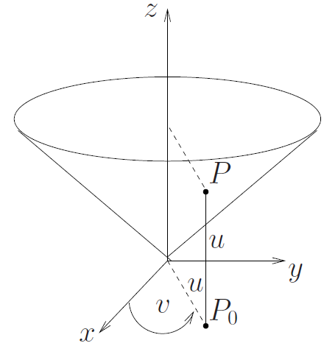
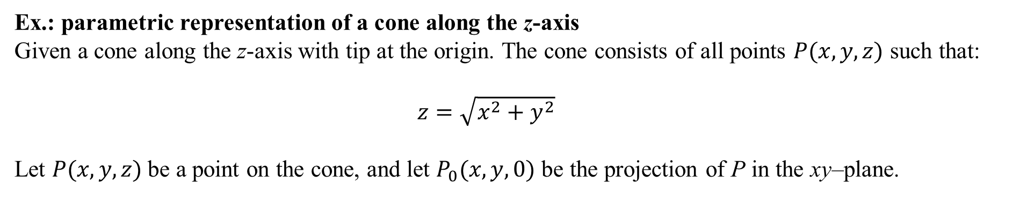
Parametric representation of a surface S
Ex.: parametric representation of a cone along the z-axis
Given a cone along the z-axis with tip at the origin. The cone consists of all points $P(x,y,z)$ such that:
$z=\sqrt{x^{2}+y^{2}}$
Let $P(x,y,z)$ be a point on the cone, and let $P_{0}(x,y,0)$ be the projection of P in the xy–plane.
Here the variable v is the angle between the x–axis and the position vector ${\vec{r}}_{0}=(x,y,0)$ of $P_{0}$.
We have
$$x\left(u,v\right)=ucosv y\left(u,v\right)=usinv and z\left(u,v\right)=\sqrt{{(ucosv)}^{2}+{(usinv)}^{2}}=u$$
J. Schmiegel: Lecture notes
Then we have the parametric representation:
$\vec{r}\left(u,v\right)=\left(ucosv,usinv,u\right) 0≤u 0≤v≤$2 $π$

Slide 14

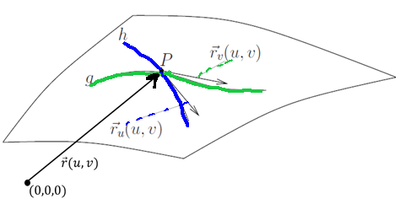

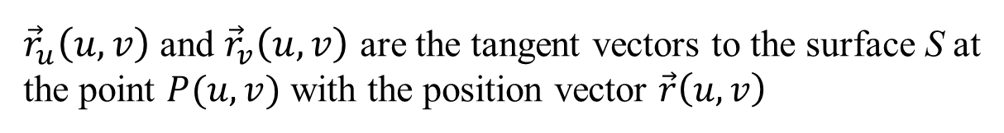
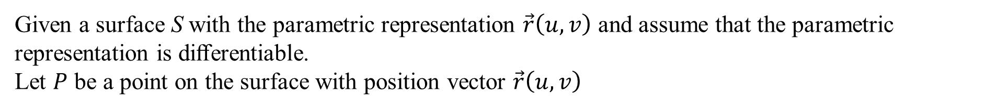
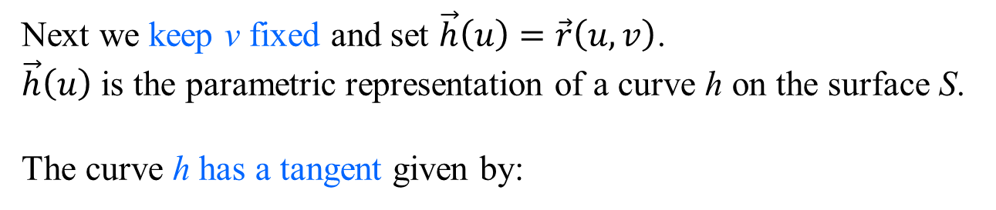
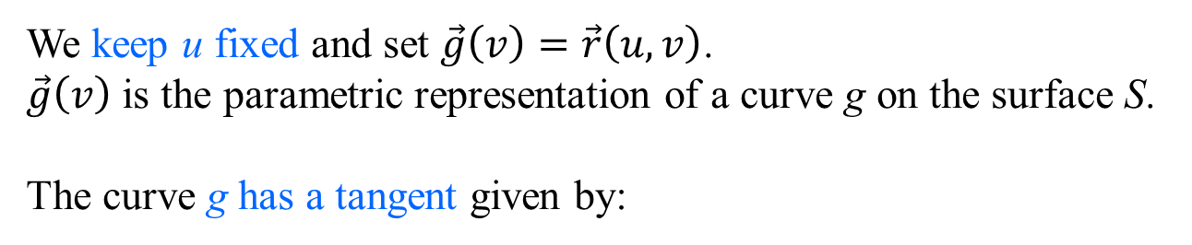
Tangent vectors to a surface S
Given a surface S with the parametric representation $\vec{r}\left(u,v\right)$ and assume that the parametric representation is diﬀerentiable.
Let $P$ be a point on the surface with position vector $\vec{r}\left(u,v\right)$
We keep u fixed and set $\vec{g}\left(v\right)=\vec{r}\left(u,v\right)$.
$\vec{g}\left(v\right)$ is the parametric representation of a curve g on the surface S.
The curve g has a tangent given by:
Next we keep v fixed and set $\vec{h}\left(u\right)=\vec{r}\left(u,v\right)$.
$\vec{h}\left(u\right)$ is the parametric representation of a curve h on the surface S.
The curve h has a tangent given by:
${\vec{r}}_{u}\left(u,v\right)$ and ${\vec{r}}_{v}\left(u,v\right)$ are the tangent vectors to the surface S at
the point $P(u,v)$ with the position vector $\vec{r}\left(u,v\right)$
J. Schmiegel: Lecture notes

Slide 15

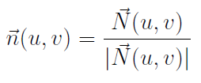
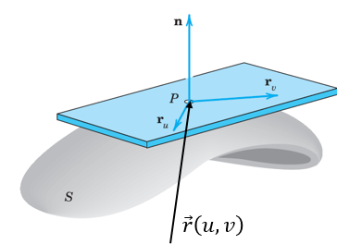
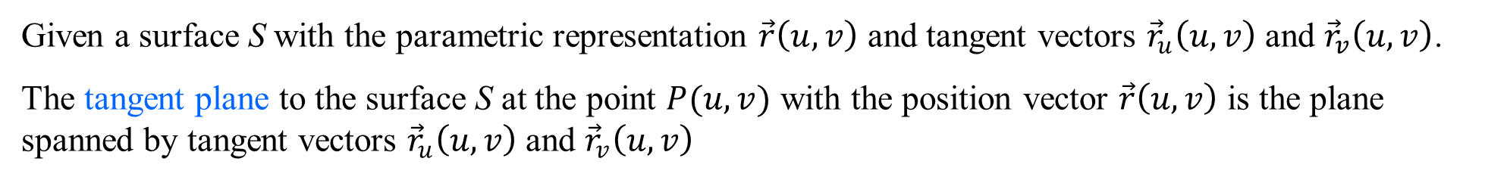
Surface normal vectors to a surface S
Given a surface S with the parametric representation $\vec{r}\left(u,v\right)$ and tangent vectors ${\vec{r}}_{u}\left(u,v\right)$ and ${\vec{r}}_{v}\left(u,v\right)$.
The tangent plane to the surface S at the point $P(u,v)$ with the position vector $\vec{r}\left(u,v\right)$ is the plane spanned by tangent vectors ${\vec{r}}_{u}\left(u,v\right)$ and ${\vec{r}}_{v}\left(u,v\right)$
The surface normal vector is the vector product:
The surface normal vector is orthogonal to the tangent plane.
The unit surface normal vector is the normalized vector (normalized to length 1):
E. Kreyszig:
Advanced Engeneering Mathematics

Slide 16
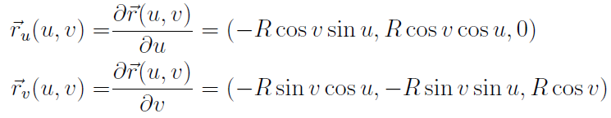
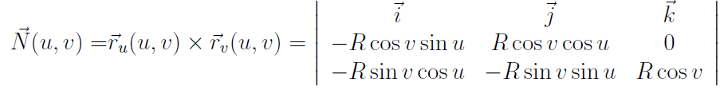
Tangent vectors and surface normal vectors to a surface S
Ex.:
Given a sphere with radius R and centre at the origin, and by the parametric representation:
$$\vec{r}\left(u,v\right)=\left(Rcosucosv,Rsinucosv,Rsinv\right) 0≤u≤2π −\frac{π}{2}≤v≤\frac{π}{2}$$
Then the tangent vectors are:
The surface normal vector is:

Slide 17
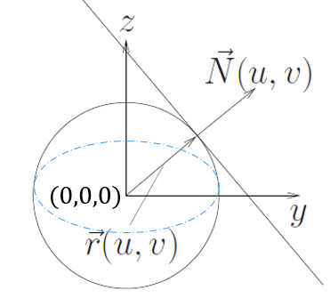


Tangent vectors and surface normal vectors to a surface S
Ex. cont.:
The sphere with radius R and centre at the origin, and given by the parametric representation:
$$\vec{r}\left(u,v\right)=\left(Rcosucosv,Rsinucosv,Rsinv\right) 0≤u≤2π −\frac{π}{2}≤v≤\frac{π}{2}$$
The tangent vectors are:
The surface normal vector is: $\vec{N}\left(u,v\right)=R\left(cosv\right)\vec{r}\left(u,v\right)$
i.e. the surface normal vector has the direction of $\vec{r}(u,v)$
J. Schmiegel: Lecture notes
The length of $\vec{N}\left(u,v\right)$ is:
The unit surface normal vector is:

Slide 18
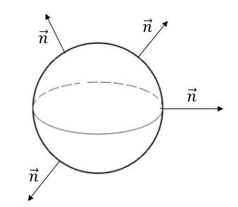
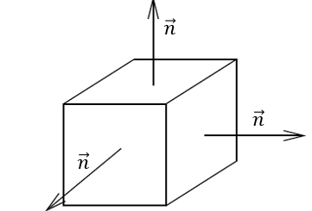
Smooth surfaces
Given a surface S with the parametric representation $\vec{r}\left(u,v\right)$ and a unit surface normal vector $\vec{n}\left(u,v\right)$.
The surface S is called smooth if $\vec{n}\left(u,v\right)$changes continuously over S.
The surface S is called piecewise smooth if S consists of ﬁnitely many smooth surfaces.
Ex.:
A sphere is smooth
A cube is not smooth but piecewise smooth
J. Schmiegel: Lecture notes

Slide 19
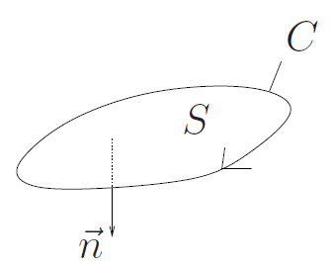
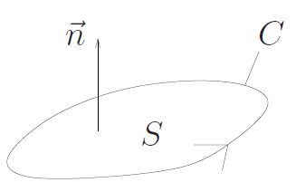
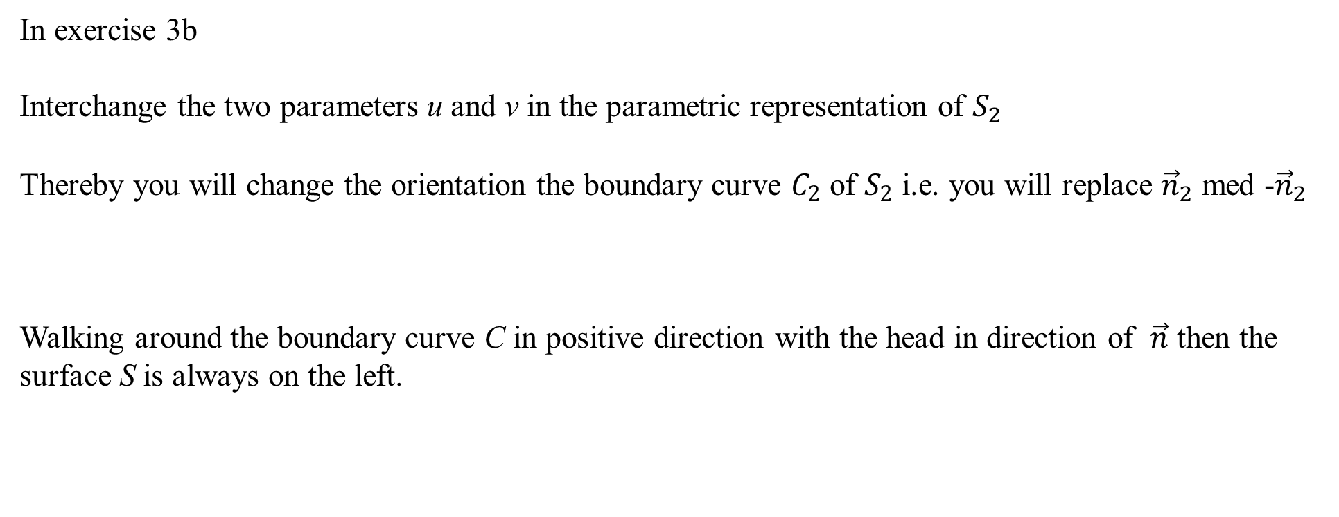
We are doing exercises from lecture notes 4
In exercise 3b
Interchange the two parameters u and v in the parametric representation of $S_{2}$
Thereby you will change the orientation the boundary curve $C_{2}$ of $S_{2}$ i.e. you will replace ${\vec{n}}_{2}$ med -${\vec{n}}_{2}$
Walking around the boundary curve C in positive direction with the head in direction of $\vec{n}$ then the surface S is always on the left.
J. Schmiegel: Lecture notes

Slide 20
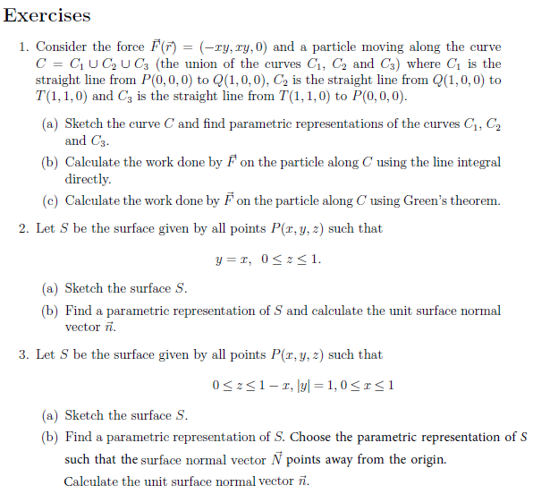
We are doing exercises from lecture notes 4

